Slide 1







Concept
HOW IT WORKS
After selecting a company app automatically downloads needed financials and computes DCF and shows stock’s current price.
SMARTPHONE APPS
Series of finance applications for smartphones related to stock market. The first one will show stock market share pricing according to Discounted Cash Flow (DCF) model
Tesla
Current price
$274.96
DCF
DCF Price
$302,81
DISTRIBUTION
The app will be available on iPhones (App Store) and Android (Google Play)
ASSUMPTIONS
The app will be released one at the time. We are a plan to release 3-4 applications in the first year. The release will be the DCF app.
1

Slide 2
Market Analysis
Target group
Investors
Finance and Tech majors students
Mobile Users
Financial apps users
Stats about Financial app users
17% of all smartphones users have at least one investing app
on its smartphone (over 43 million)
Our realistic target is 0.1% of all Investing app users which gives
43 741 potential customers
https://www.bankrate.com/pdfs/pr/20180208-Fintech-Survey.pdf
https://www.bankrate.com/personal-finance/smart-money/americans-and-financial-apps-survey-0218/

Slide 3
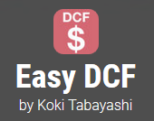
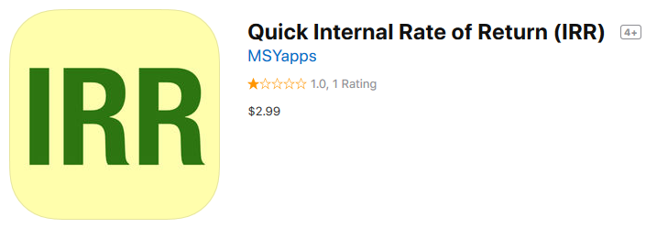
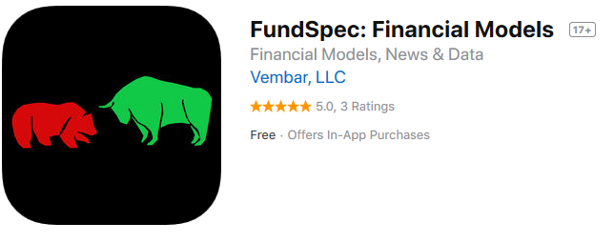
Competition
Potential competitors - applications from App Store
Apart from FundSpec application, there is no other free app that allows finding DCF for a particular company. Two first apps are just calculators where user have to input data manually.
An exclusive value of our app
Only our app in the premium version will provide adjusted DCF. Plain DCF model without relevant assumptions shows for some companies unrealistic price, our analytics will provide relevant assumptions to the model.

Slide 4
Revenue Model
 | Free | Premium
Revenue source | Advertising (banner ads) | Yearly subscriptions: $30 - $40 per year (~ $3 per month)
Feautures | Plain DCF price for selected stock | Adjusted DCF by market analytics
Number of downloads per one app | 3000 – 43 741 in the first year | Up to 1000 premium subscriptions
Revenue per app in the first year* | $2304 - $23 040 | $5 000 - $40 000
Total revenue per app series (3 – 4 apps) | $6912- $92 160 | $15 000 - $160 000
Total revenue in the first year | $21912 – $252 160
*Average Daily User Sessions: 1000 – 10000, Average Minutes Per Session: 2, Ad Impressions Per Minute: 2, Ad Network Fill Rate (%): 80%, eCPM($): 2
http://ryanmorel.com/mobile-advertising-calculator/

